Slide 1



Slide 2
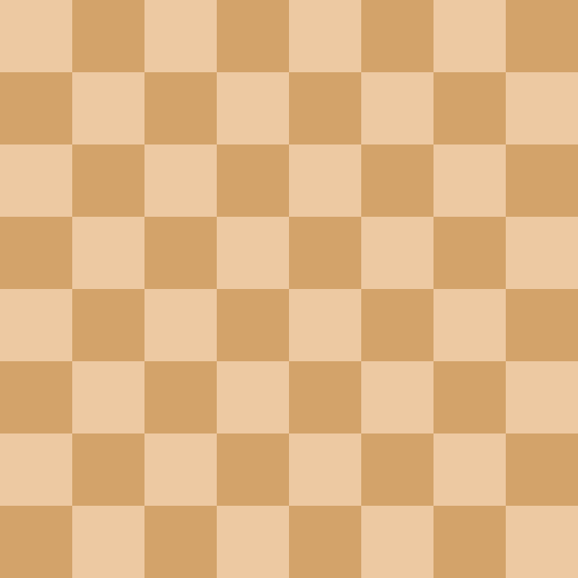

Chess King’s Council
Load Game
New Game

Slide 3
Chess King’s Council
Load Game
New Game

Slide 4
Chess King’s Council
Load Game
New Game

Slide 5
Chess King’s Council
Load Game
New Game
Create Piece

Slide 6

Chess King’s Council
New Game
Load Game
Create
Piece
Chess Rules
Council Rules
My Images
Author’s GitHub

